Slide 1

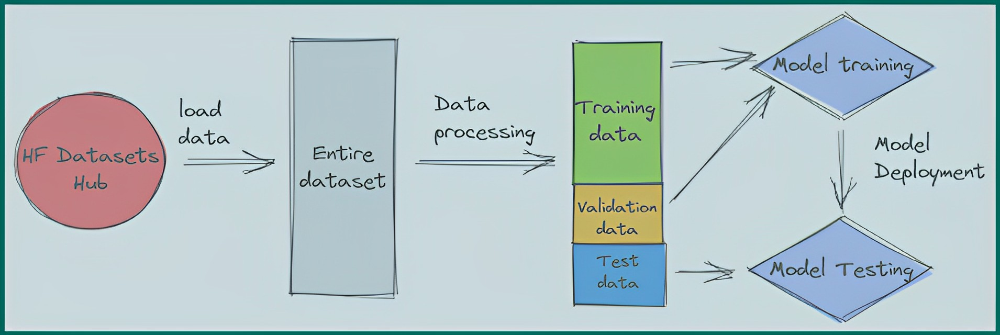
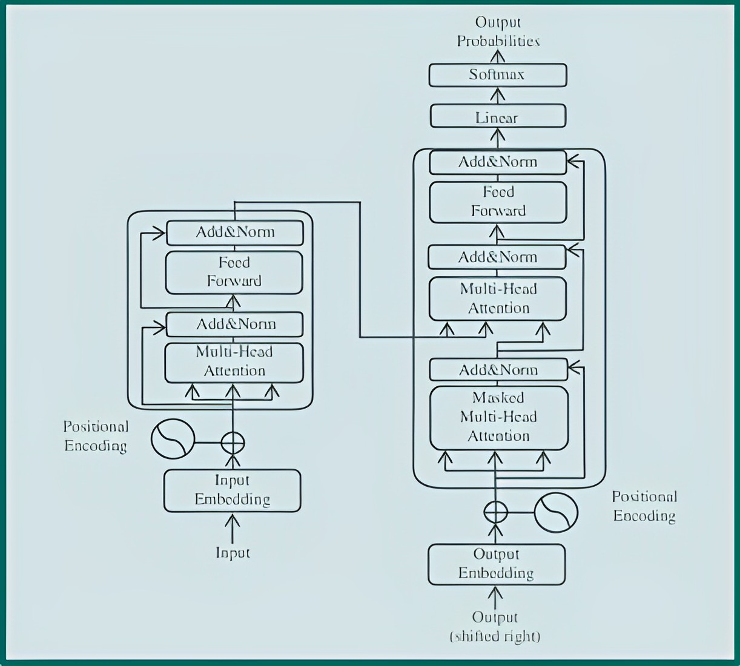
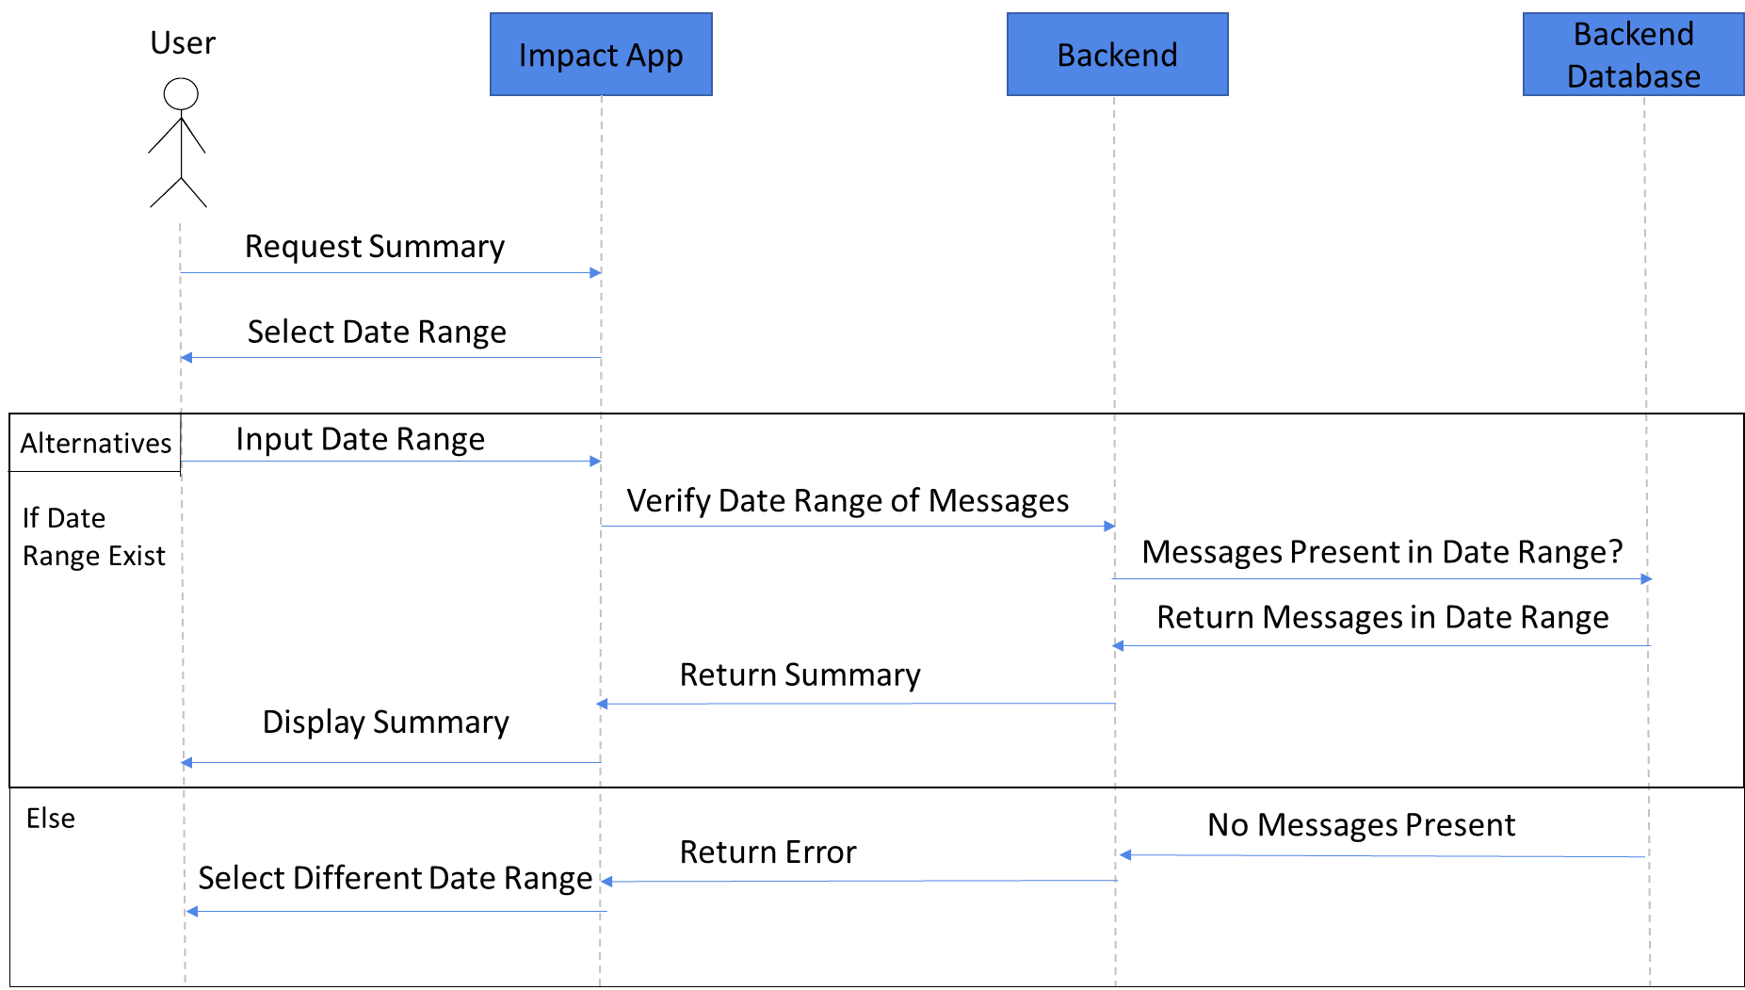

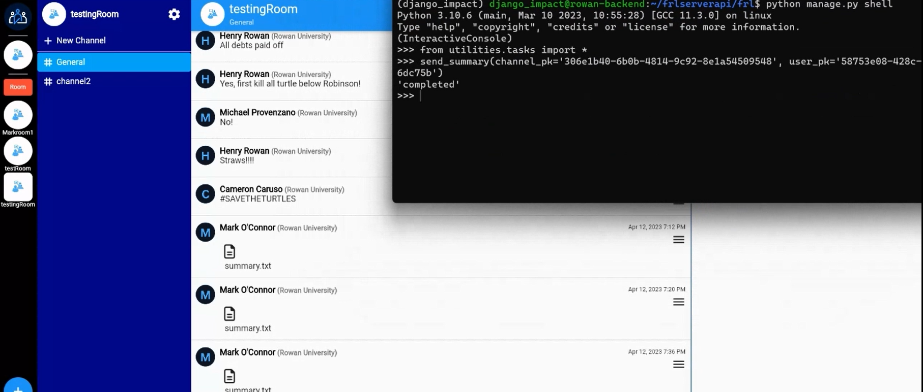

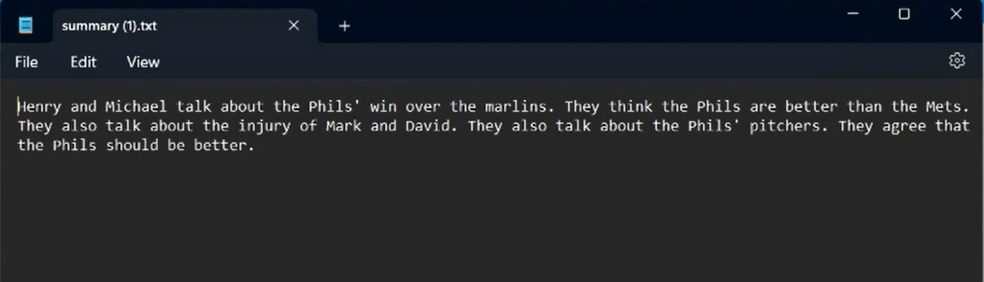
Abstractive Conversation Summarizer With Open Source AI Tools (ACSWOSAT)
Akshat Baranwal, Cameron Caruso, Mark O'Connor, Michael Provenzano, Parth Dalwadi, Steven Warner
Dr. Neil Toporski (Faculty Advisor)
Abstract: Criminals often take advantage of information silos to hide from the view of the law. Information silos in this context are described as rigid or compartmentalized structures and the current communication structures of police departments are often plagued by them. These silos are combated by the secure messaging services provided by IMPaCT Intell. A key feature IMPaCT Intell wishes to implement is the speedy dissemination of information. In recent years, advancement in machine learning models have allowed for natural language processing at a near human level. We have utilized open source Python tools to implement and train an abstractive summarization tool that will aid police departments in quickly sending information by summarizing text channels.
How does a summarizer works?
Model?
Transformer Model
A transformer model is a type of neural network architecture used in natural language processing (NLP) tasks such as language translation, text generation, and summarization. It is designed to address some of the limitations of previous NLP models.
The transformer model processes input text through multiple layers of encoders and decoders. The encoder part of the model reads and processes the input text, while the decoder part generates a summary of the input text based on the encoded information.
The transformer model allows for the processing of inputs in parallel rather than sequentially, making it much faster and more efficient than previous NLP models. This is achieved through the use of self-attention mechanisms, which allow the model to learn dependencies between different parts of the input text.
In the context of a summarization tool, a transformer model can be trained on large amounts of text data to generate summaries of input text. The input text is first processed by the encoder, which generates a representation of the input text. This representation is then used by the decoder to generate a summary of the input text.
A summarization tool works by analyzing large amounts of text data and generating a shorter summary that captures the main ideas and key points.
To build such a tool, the first step is to gather data from a server, which is then converted into text files. The text data is preprocessed, which involves tokenization, sentence segmentation, and other NLP techniques.
The preprocessed data is then divided into training, validation, and test sets. The training and validation sets are used to train a machine learning model, such as a neural network, using techniques like transfer learning, fine-tuning, or sequence-to-sequence modeling. The trained model is then deployed to generate summaries of new text.
The test set is used to evaluate the performance of the model, using metrics like ROUGE and BLEU scores. The performance of the model is then improved by fine-tuning the model architecture, adjusting hyperparameters, or using more advanced techniques like reinforcement learning.
Visual Demonstration
How is success measured?
The success criteria for the summary generator project will be based on the precision and recall of the model, as well as its ability to maintain semantic accuracy in generated summaries. The team will also measure success based on the model's safe integration into the existing server environment.
To measure precision, the Bleu Score metric will be used during training. This will involve calculating the similarities between generated summaries and target summaries. Recall will be measured using the ROGUE Score, which will track the number of words in the generated summary that appear in the reference summary. To ensure semantic accuracy, the METEOR Score metric will be used to align the words in the generated and target summaries.
During training, the model will be trained until all three metrics have a minimum value of approximately 0.20. These scores will be evaluated during training sessions to ensure quality and accuracy. By using these metrics and a rigorous training process, the team aims to develop a summary generator that meets high standards of precision, recall, and semantic accuracy, while also integrating safely into the existing server environment.
Request Summary
SEQUENCE DIAGRAM
1. Backend Importing texts from channel testingRoom” and processing it.
2. Summary.txt getting downloaded after the model is done processing.
ACSWOSAT
Scores:
Rouge 'rougeLsum': 0.3467233649605668
Bleu 'precisions': 0.4035433070866142
Meteor 'meteor': 0.30535254820292623
3. We have our summary as text file here.

